Slide 1
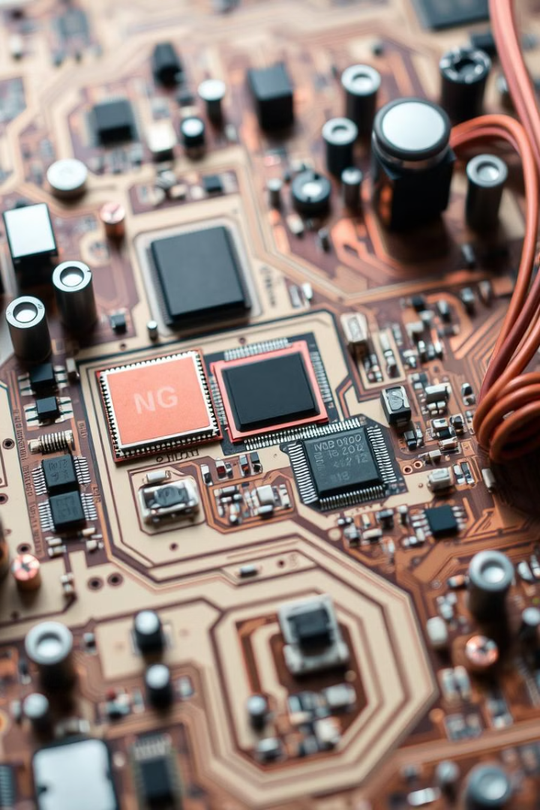

Comparing ARM, PIC, and AVR Microcontrollers
The world of microcontrollers offers a diverse range of options, each with its own unique features and capabilities. This presentation will delve into three popular microcontroller families: ARM, PIC, and AVR, comparing their strengths, architectures, and use cases.
PH
by P Haarika

Slide 2

ARM Microcontrollers: Overview and Strengths
1
Advanced Architecture
2
Wide Range of Devices
3
Extensive Ecosystem
ARM microcontrollers boast a sophisticated architecture, known for its high performance and versatility.
The ARM family offers a wide range of devices, ranging from tiny microcontrollers to powerful processors.
ARM enjoys a robust ecosystem of development tools, libraries, and community support.

Slide 3
PIC Microcontrollers: Overview and Strengths
Simplicity and Ease of Use
Low Power Consumption
Cost-Effectiveness
PIC microcontrollers are known for their ease of use and straightforward programming models.
PIC devices are designed for low power consumption, making them ideal for battery-powered applications.
PIC microcontrollers often offer a cost-effective solution for many embedded projects.

Slide 4
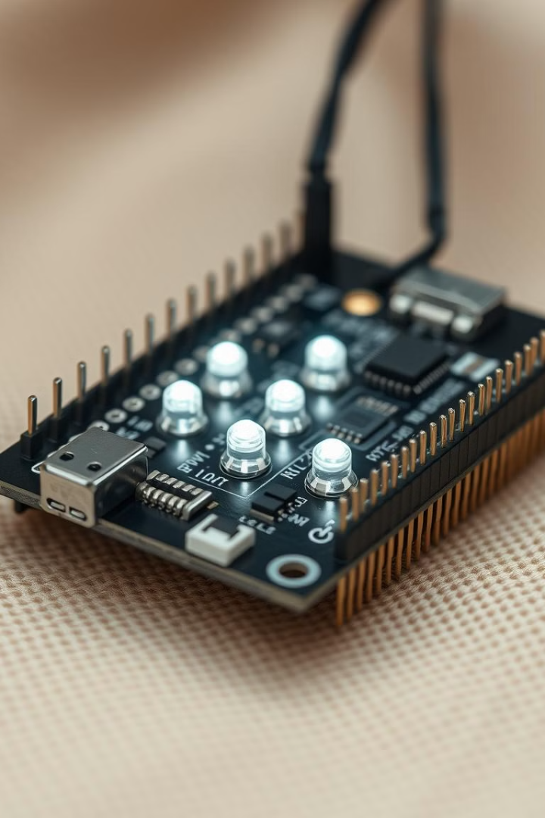
AVR Microcontrollers: Overview and Strengths
1
Legacy and Popularity
AVR microcontrollers have a long history and continue to be popular in various applications.
2
Robust Peripherals
AVR microcontrollers offer a comprehensive range of peripherals for various tasks, including communication and control.
3
Powerful Development Tools
AVR microcontrollers benefit from a wide array of development tools, including compilers and debuggers.

Slide 5
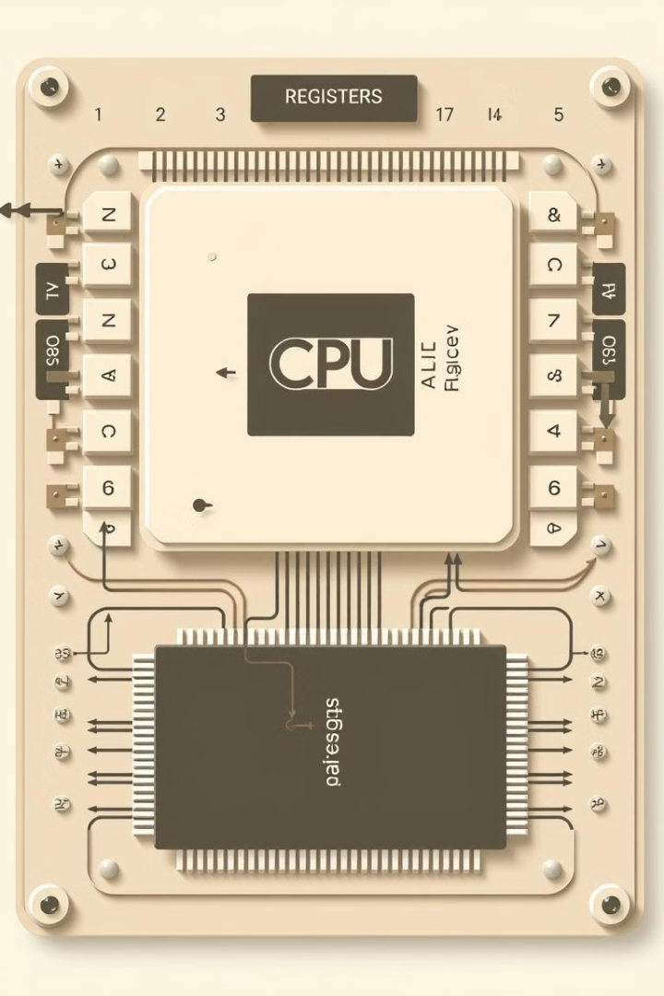
Comparison of CPU Architectures and Performance
Feature
ARM
PIC
AVR
Instruction Set
RISC (Reduced Instruction Set Computing)
RISC
RISC
Clock Speed
High (up to GHz)
Medium (up to MHz)
Medium (up to MHz)
Memory Capacity
Large (up to GB)
Small (up to KB)
Small (up to KB)

Slide 6
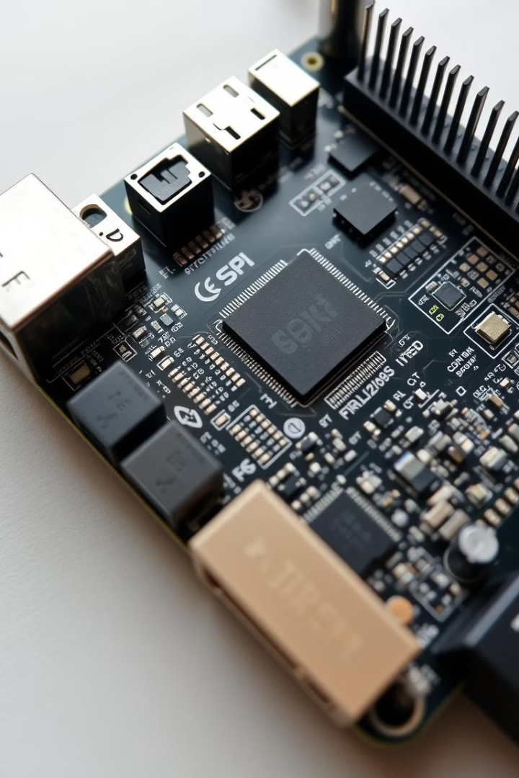




Peripherals and Connectivity: ARM vs. PIC vs. AVR
USB
Bluetooth
ARM and AVR microcontrollers often feature built-in USB interfaces for data transfer and communication.
ARM microcontrollers often include Bluetooth support for wireless communication.
Ethernet
Wi-Fi
ARM microcontrollers frequently have Ethernet support for high-speed wired communication.
ARM microcontrollers often feature built-in Wi-Fi for wireless internet connectivity.

Slide 7




Power Consumption and Energy Efficiency
ARM
ARM microcontrollers offer a range of power consumption options, with some devices optimized for low power.
PIC
PIC microcontrollers are known for their low power consumption, making them suitable for battery-operated applications.
AVR
AVR microcontrollers generally offer moderate power consumption, but some devices are optimized for low power applications.

Slide 8
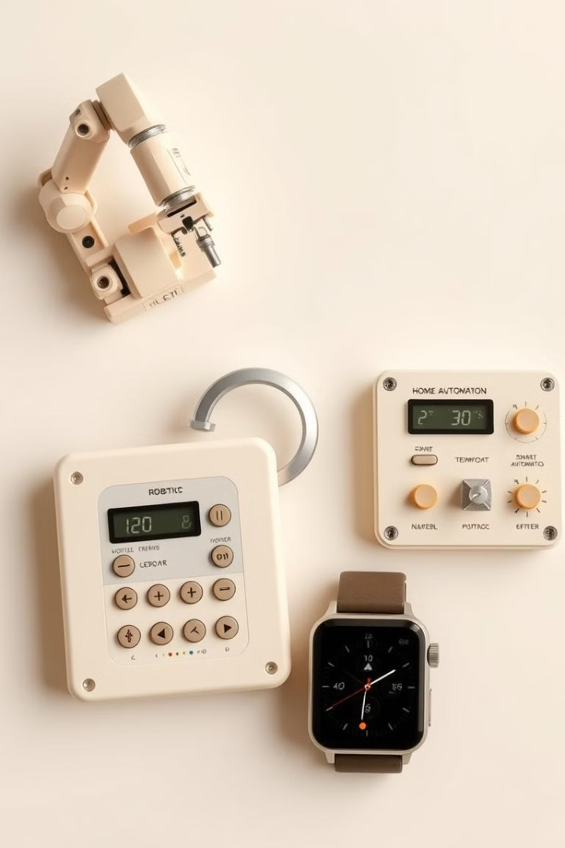
Use Cases and Application Scenarios
Industrial Automation
Consumer Electronics
ARM and PIC microcontrollers are commonly used in industrial automation systems for process control and monitoring.
ARM and AVR microcontrollers are prevalent in consumer electronics, such as smartphones, tablets, and smartwatches.
Robotics
ARM microcontrollers are often employed in robotics for controlling motors, sensors, and actuators.

Slide 9

Conclusion
Each microcontroller family offers distinct advantages, making them suitable for various applications. Choosing the right microcontroller depends on the specific requirements of the project, including performance, power consumption, and cost.

